Slide 1
Class - CMPS 4143 Java/Python
Instructor - Dr. Siakat
Project - Lottery simulation game
Author 1 Ethan Coyle
author 2 Jonathan hogan

Slide 2
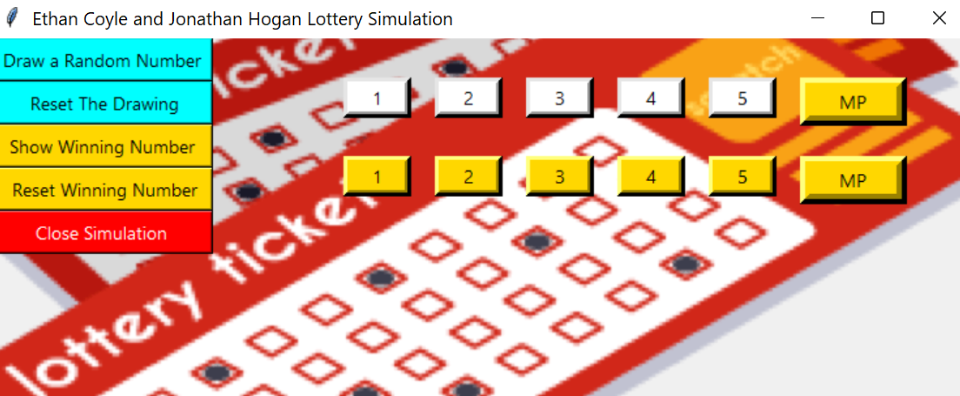

Slide 3

Our Proposal
When we first proposed this project, we stated that we wanted to create a lottery simulator in which we would successfully imitate a life-like simulator with the lottery that utilizes true to life drawing and winning number comparison

Slide 4

Proposal part 2
We also proposed that we would create a program in which the user would be able to draw a random number with a click of a button where the machine would draw a random set f numbers and a multiplier number that would act as if they went to a corner store and purchased a quick pick number

Slide 5
Our approach
at first, we approached this program with an open mind. We had to do research into seeing how the lottery game actually works on the large scale from the drawing numbers and the user drawings. We then determined the range of numbers of each of the balls both drawn and winning numbers.the technology that we used was using the tkinter graphical user interface in python where a window is created and all of our items are contained within. There was not really any formulas that we used aside from us having to make sure none of the drawn numbers were repeated from the random number generator. In conclusion, after our program was done we realized how astronomically low the chances of all the numbers on the winning numbers and the user numbers matching up especially with the range of numbers in which each of the balls range.

Slide 6
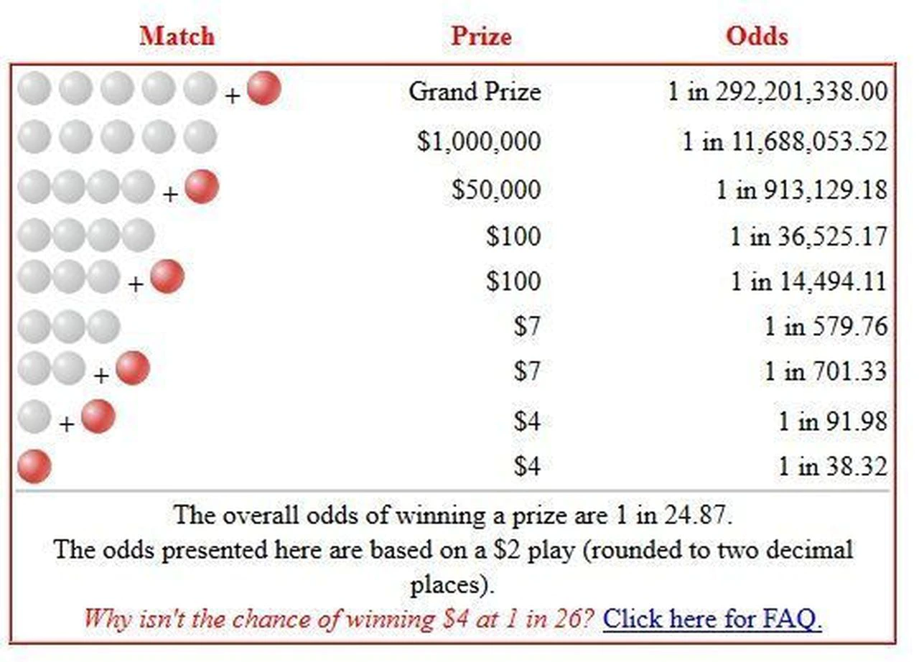

Slide 7
WE split up our program initially into two parts for each of us to work equivalently
Part 1 was setting up the graphical user interface and all the associated components
Part 2 was to create the interface to display the numbers whenever the buttons were pressed and updated the numbers inside of the labels accordingly
Team contributions

Slide 8
Jon Contributions
Contributions to this program was to set up the number generator using the definitions and to ensure that the numbers would not repeat and be updated every time the reste button or generate buttons were pressed. After the buttons and gui interface was implemented, ensured that the displays displayed true numbers within the range of a real life simulation

Slide 9
ethan Contributions
My job was to implement the gui interface and set up the labels and buttons to interact with jons number generator for both of the winning numbers and the user drawing. I was also in charge of setting up the placement of everything inside of the gui window to create a user friendly display in which the user can easily see everything that is going on in the window and fully interact with everything in the window

Slide 10
There were a few challenges that we expected to face when approaching this program
We expected that working with the graphical user interface would likely cause issues due to the fact that neither one of us had ever experienced working with a GUI interface before so it was new ground to both of us
Another challenge we expected to face was the fact that having the random number generator might pose a challenge due to the unforeseen events working in python and tkinter interface.
Lastly we expected to run into issues in creating a true to life simulation that the user can experience and see how a real life situation would truly be modelled
What challenges we expected to face

Slide 11
Challenges that we experienced
True to our proposal, our biggest issue overall was dealing with tkinter GUI.
We experienced a lot of difficulties with this graphical user interface. The first issue we had was creating the labels and buttons. While this was practically new to us, learning the labels and tkinter buttons was problematic because at first, nothing was working. We finally figured out how to get the buttons to work and update the results in the labels which showed the drawing balls and we finally figured out how to get the labels to actually display the results whenever the buttons were being pressed
Another issues we experienced was the random selection of balls we couldn’t quite work out why they were repeated numbers sometimes which in the real lottery, the numbers that are drawn never repeat so that posed a temporary challenge to both of us. We finally figured out how to get it where none of the values were repeated in either the drawn numbers or the winning numbers
Thirdly, out main issue was the placement of the labels and buttons, we had to work out the placement issues to properly display in the position that we wanted them to be by specifying the x-axis and the y-axis rather than padding to left or right.

Slide 12
How hard did this turn out to be
Overall, this program wasn’t too overly complicated the main issues that we had were the small issues that we had working with tkinter, once we figured out how to resolve those issues, everything else seemed to fall into place

Slide 13
Our final analysis of this project
Our final analysis from accomplishing we would say that our project from start to finish was a success. We successfully created a program that is efficient and accurately simulates how a real life lottery program would work. From the numbers set to run to the updated number of balls and the range of those numbers in a real world scenario, to the drawing and comparison to the winning number, our program, despite minor challenges presented a successful outcome. A person can try multiple times to try to match any of the numbers from the generated ticket and the winning number and see just how astronomically low the chances are that all the numbers will match up.

Slide 14
Future direction
For future direction on our program, both of us are wanting to possibly extend this project out now that we have successfully created a life simulation and used a graphical user interface with out lottery simulation to potentially develop this into a full fledged game or some other sort of program in which can be modelled inside of an app store where anyone is able to download it and get hands on experience with this program

Slide 15
Lets see our finsihsed program
https://replit.com/@ethancoyle71/LotterProgramCMPS4143#main.py
Link to our program

